Slide 1

Are There Different Types of Online Research Impact?
Steffen Lemke, Maryam Mehrazar, Athanasios Mazarakis, Isabella Peters
These slides can be found on Zenodo

Slide 2
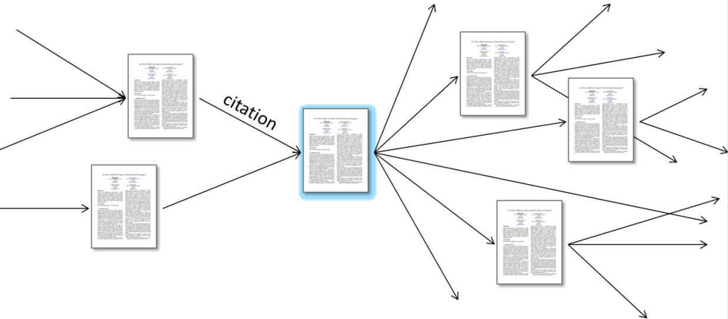
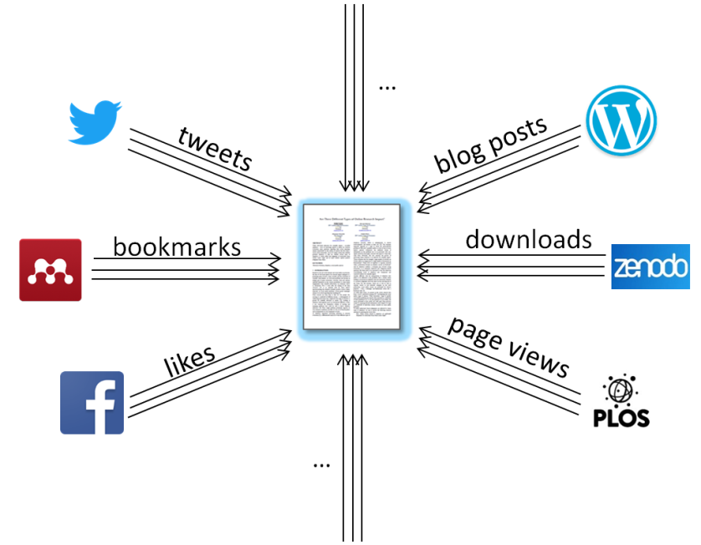
Metrics for Research Evaluation
Bibliometrics:
How often are scientific articles cited by other scientific articles?
Altmetrics/usage metrics (= web-based metrics):
How often do users interact with a scientific output online?
1
Notes:
Derivatives: Journal Impact Factor, H-Index; Altmetric Badge, PLoS ALM
The short summarizing statements of the approaches already hint at several reasons why web-based metrics are perceived as a promosing complement or alternative to bibliometrics (users, scientific outputs, timeliness, openness)
But the web-based metrics‘ diversity comes with challenges

Slide 3
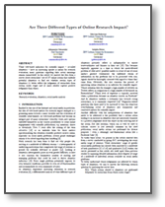
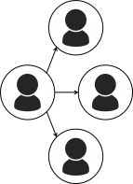




















Challenge for Web-based Metrics: Heterogeneity
Platform types
Platforms
Action types
Attention towards a scientific output
on the Web
User groups
User groups
User groups
Great heterogeneity regarding
Usage purposes
User intentions
User demographics
Techn. complexity
[…]
Icons designed by Freepik from Flaticon.
2
Notes:
Varying premises; different platform types follow different modes of communication, cater to different needs, accommodate different userships that are the originators of the measured signals; these lists are not exhaustive
So this heterogeneity leads to a lot of questions that should be adressed – many of which we aim to address during our project – but for this paper, we concentrated on two for now

Slide 4
Research Questions
To find out whether certain web-based metrics better reflect scientific experience than others, we examine…
RQ1: Which online actions are performed frequently by researchers from which career stages?
To find out which web-based metrics might be suitable indicators for scholarly appreciation, we analyze…
RQ2: Which online actions are reliably used to express positive sentiments towards their targets?
Approach:
Survey among researchers regarding their online usage behavior.
3

Slide 5
Approach: Online Survey
3,400 researchers responded (rate of response ~6%), emphases on economists (60%) and social scientists (22%)
13-20 questions about work-related usage of 90 online platforms and their functionalities
Countries of Affiliation
(Participants from
84 countries in total)
Academic Ranks
4

Slide 6













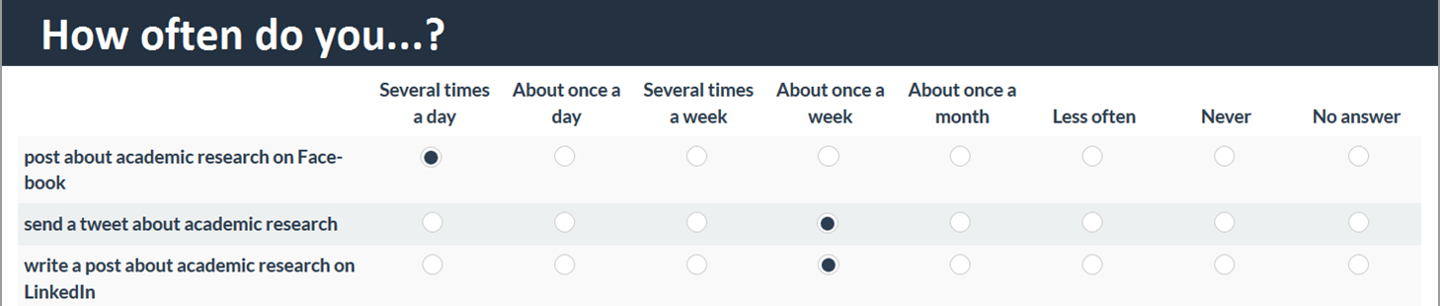
Survey Structure for RQ1
”RQ1: Which actions are performed frequently by researchers from which career stages?”
Which online platforms do you use for work?
Answer options: 90 online platforms on which interactions with scientific outputs could be measured.
For the actions available on those platforms, please estimate how frequently you perform them (in reference to academic research).
Answer options: from ‘Several times a day’ to ‘Never’, for up to 107 existing actions.
5
Notes:
Explain choice of platforms; explain choice of actions

Slide 7




























RQ1: Which online actions are performed frequently by researchers from which career stages?
58 actions used by 150+ survey respondents:
Writing
Commenting
Downloading
Liking
Sharing
Bookmarking
Other
6

Slide 8


RQ1: Which online actions are performed frequently by researchers from which career stages?
58 actions used by 150+ survey respondents:
Welch test comparisons of mean usage frequencies of early-stage researchers and professors
Writing
Commenting
Downloading
Liking
Sharing
Bookmarking
Other
Actions used more frequently by early-stage researchers:
Actions used more frequently by professors:
6

Slide 9
Survey Structure for RQ2
“RQ2: Which online actions are reliably used to express positive sentiments towards their targets?”
After the previously presented questions we additionally asked:
When you are performing the following actions, in how many cases does that indicate a positive stance on the respective target?
Answer options: ‘In all cases’, ‘In most cases’, ‘In few cases’, ‘Never’; again for up to 107 existing actions.
7

Slide 10
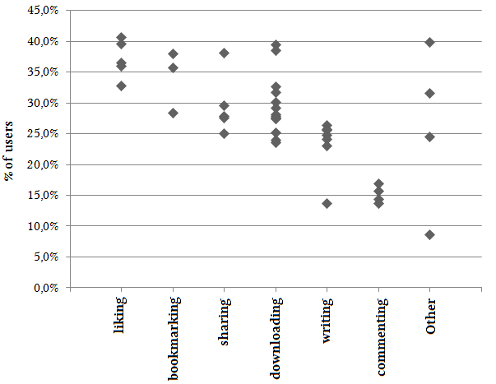
RQ2: Which online actions are reliably used to express positive sentiments towards their targets?
Share of users of an action who exclusively perform it to express a positive stance towards its target.
42 actions with responses from 150+ survey respondents:
8

Slide 11
Conclusions
Users of web-based metrics need to differentiate carefully with regard to platforms and action types that metrics are based on.
Different platforms/actions reflect different users‘ judgments.
Aggregations are dangerous.
If needed, examining individual actions closely can reveal shared properties that might serve as a basis for reasonable aggregations.
Or, more optimistically: web-based metrics for research assessment offer much more interesting information as is currently utilized!
9

Slide 12




Web: metrics-project.net
Email: s.lemke@zbw.eu
Twitter: @metrics_project, @stl90
Thank you!

Slide 13


Slide 14
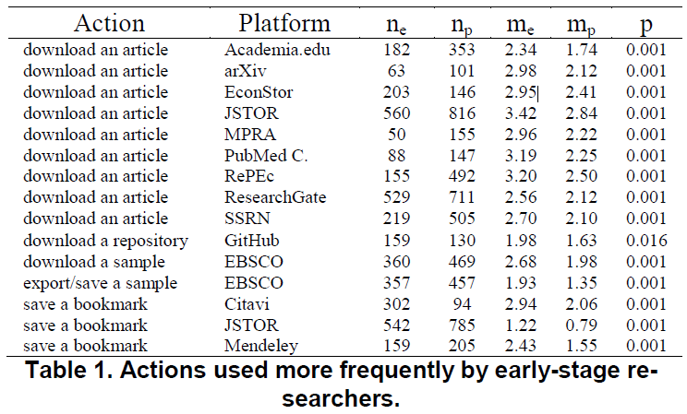
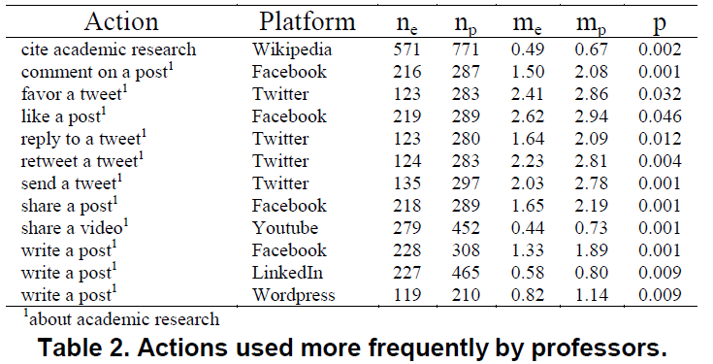
RQ1: Results from Welch tests as tables

Slide 15
Study Limitations
The study‘s sample was heavily biased towards economists/social scientists as well as researchers from Germany
Although it might be a reasonable assumption that the lion‘s share of online interactions with scientific products is performed by researchers, the influence of non-academic users on web-based metrics should be considered in future studies as well
The survey results reveal only a temporary snapshot of the participating researchers‘ social media usage – reliable predictions about researchers‘ long-term behaviour are not possible
General weakness of surveys: dependency on the participants‘ perceptions and memories

